Slide 1
Chapter 25
TCP/IP
Protocol Suite:
Part 2,
Application Layer

Slide 2
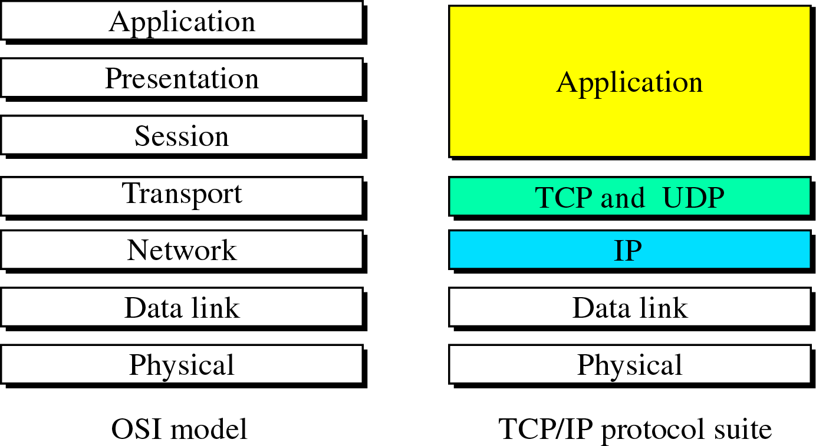
Figure 25-1
Comparison between OSI and TCP/IP

Slide 3
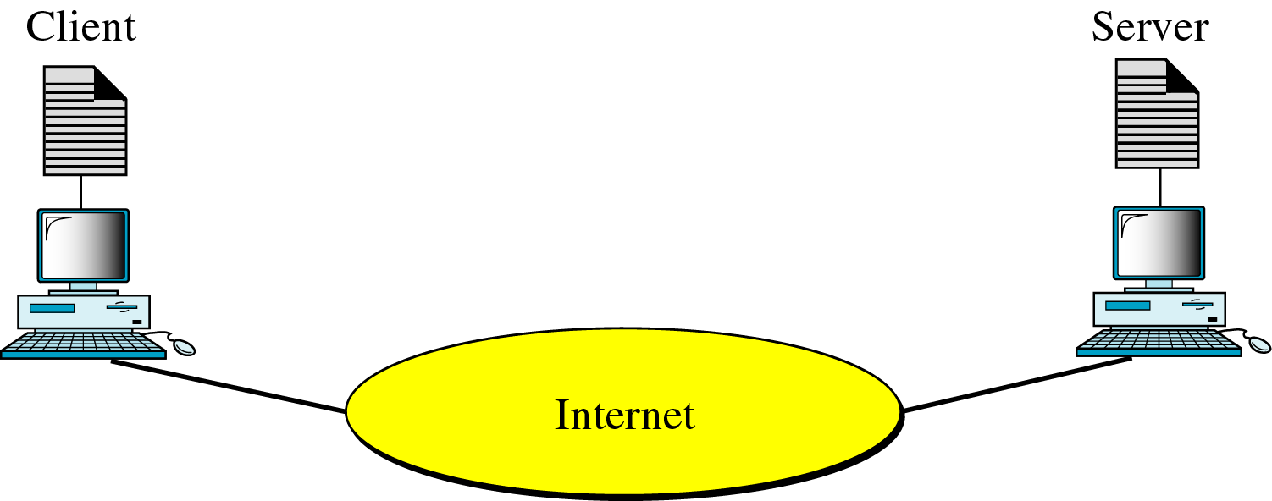
Figure 25-2
Client-Server Model

Slide 4
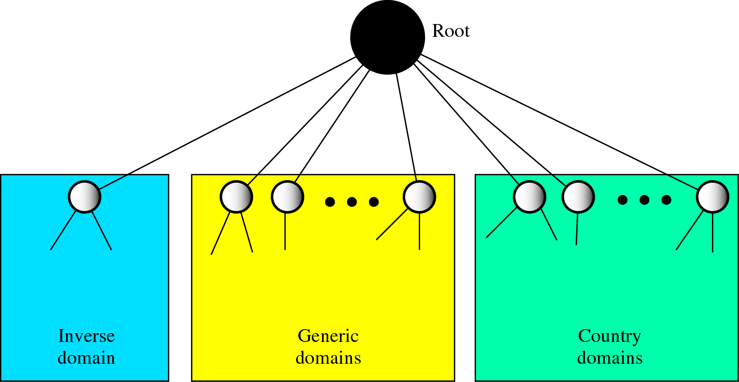
Figure 25-3
DNS in the Internet

Slide 5
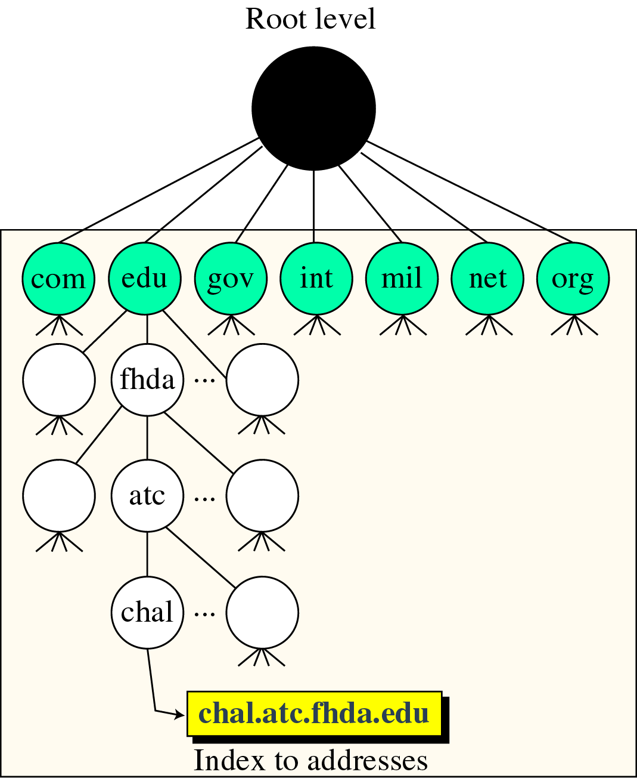
Figure 25-4
Generic Domains

Slide 6
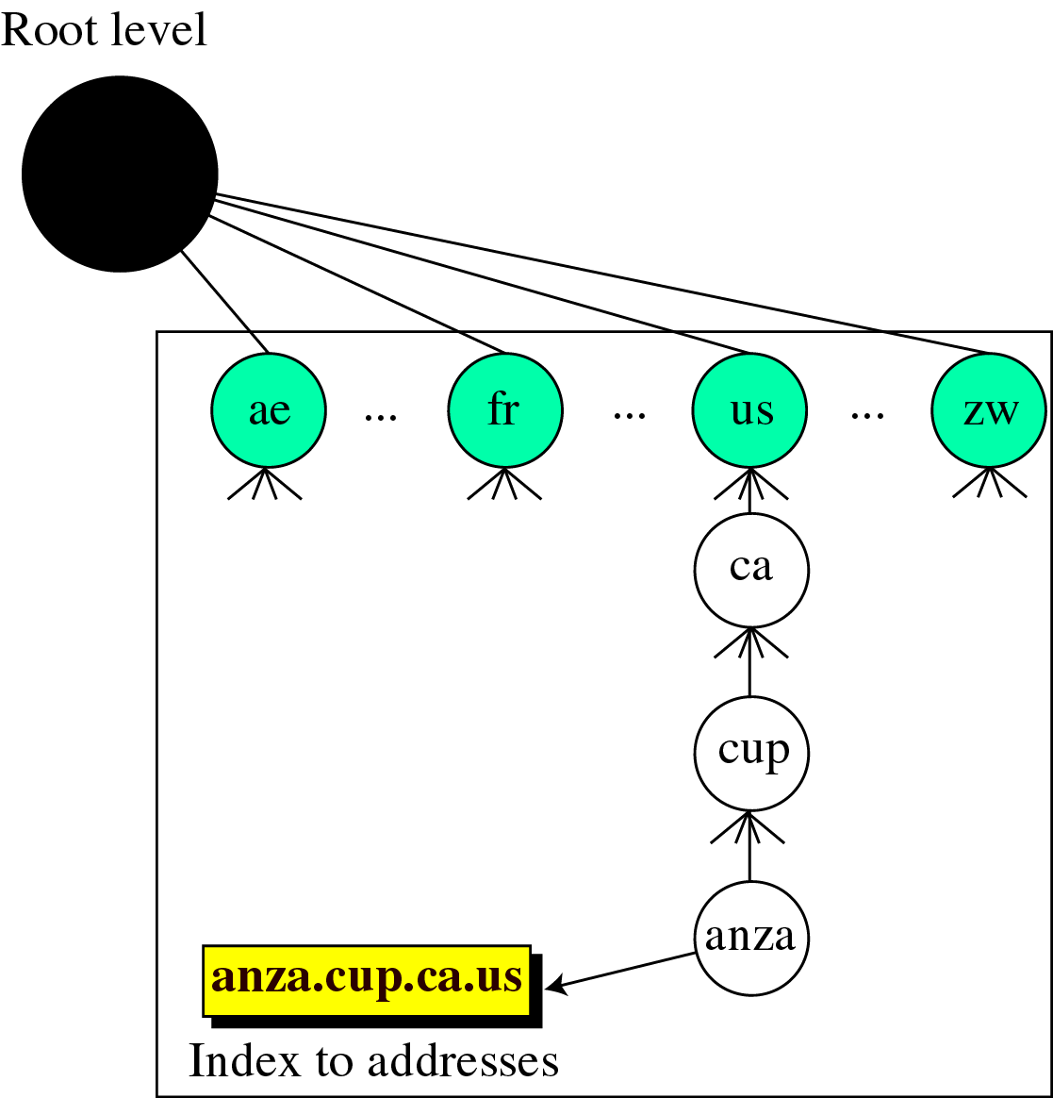
Figure 25-5
Country Domains

Slide 7
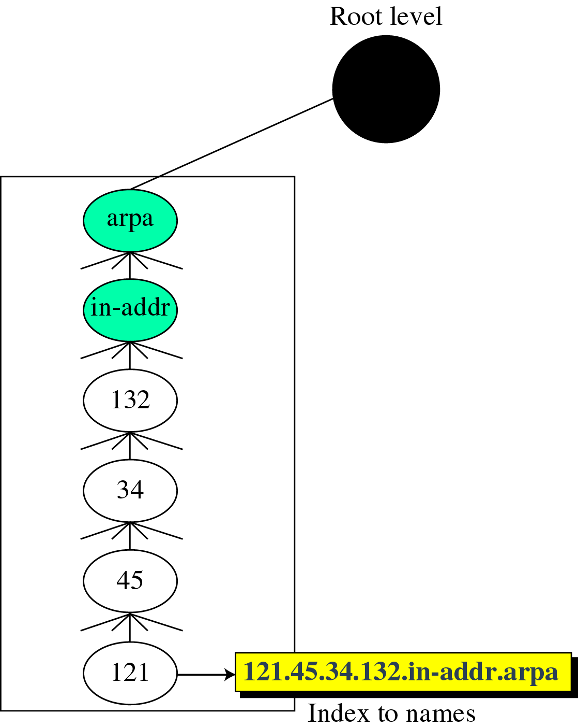
Figure 25-6
Inverse Domain

Slide 8
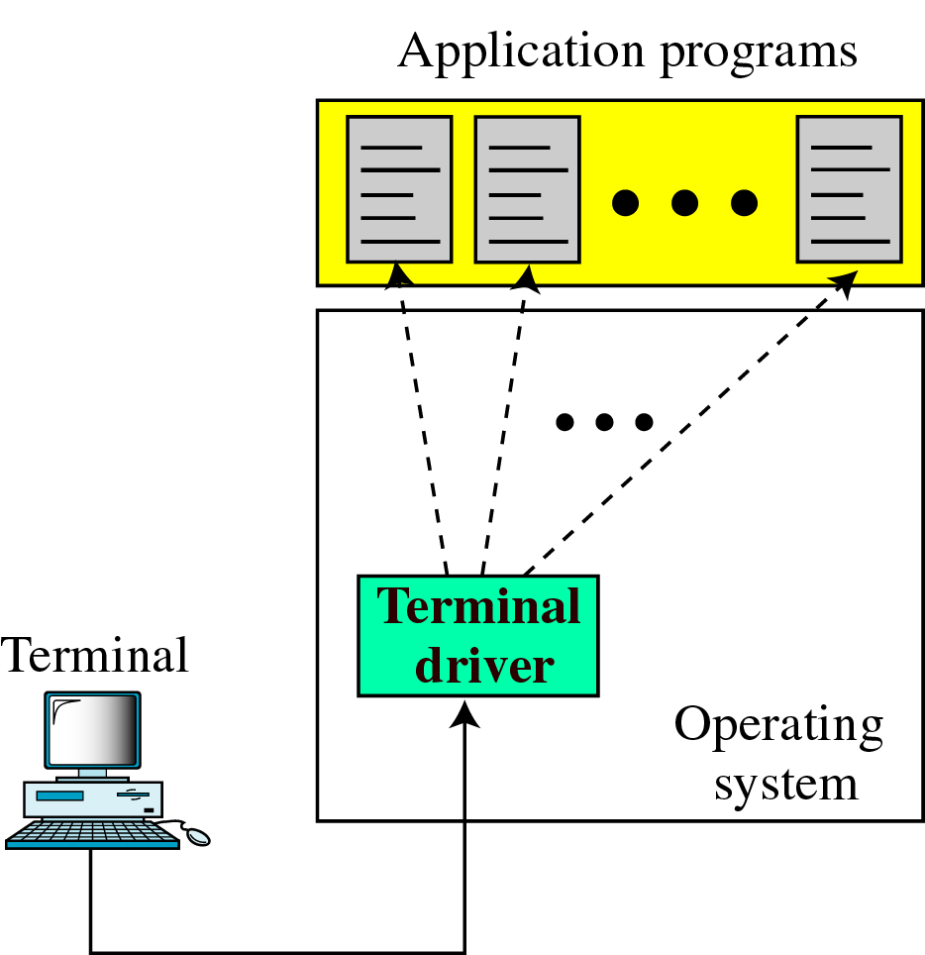
Figure 25-7
Local Login

Slide 9
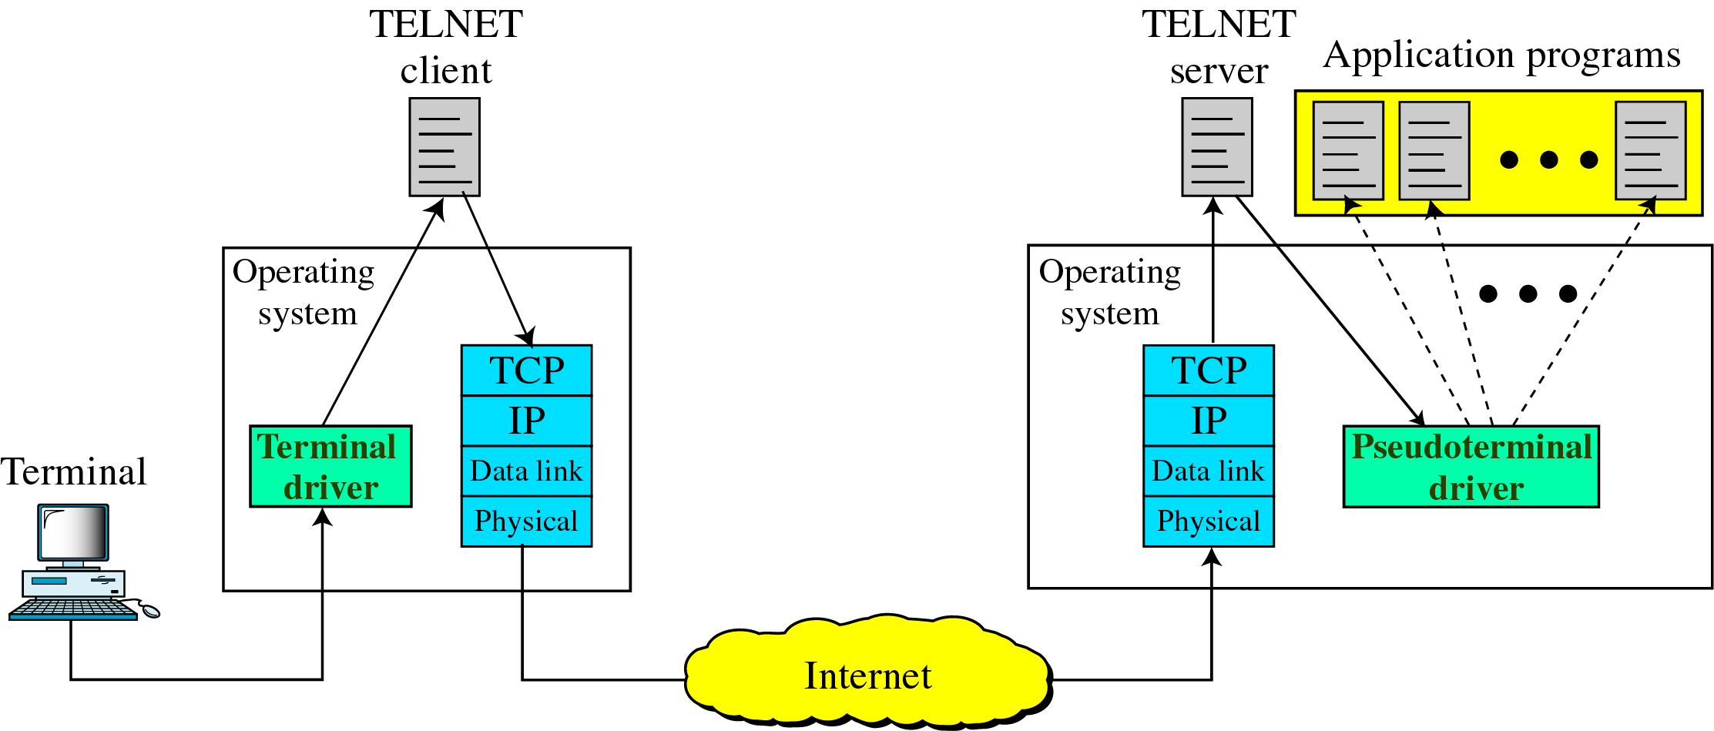
Figure 25-8
Remote Login

Slide 10
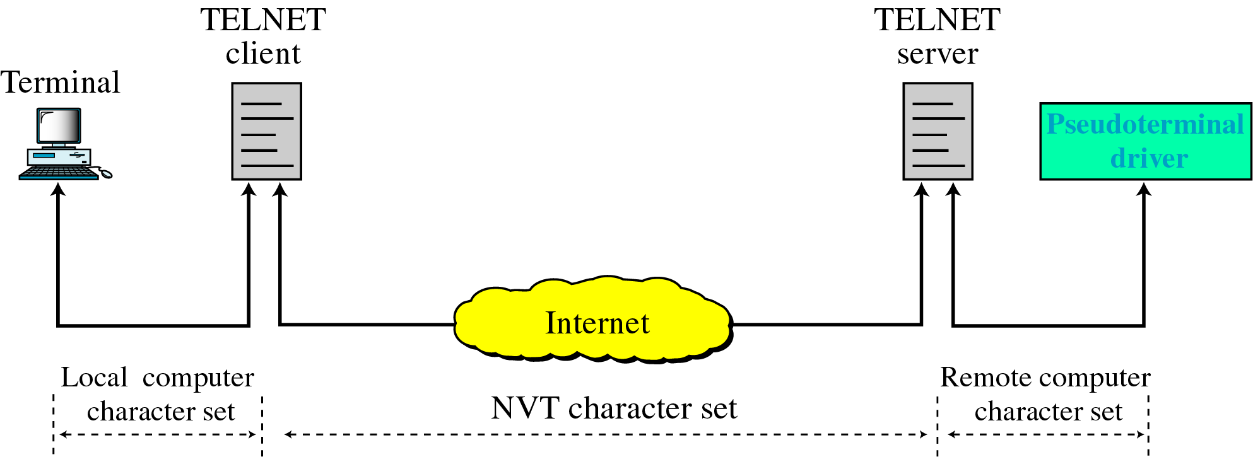
Figure 25-9
Concept of NVT

Slide 11
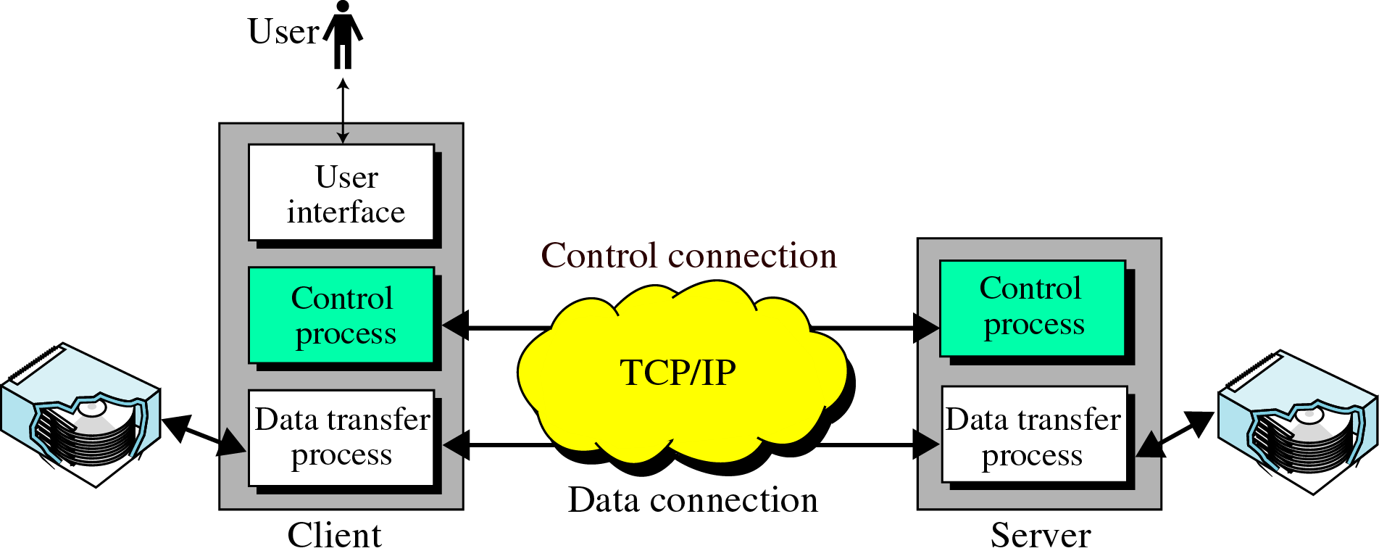
Figure 25-10
FTP

Slide 12
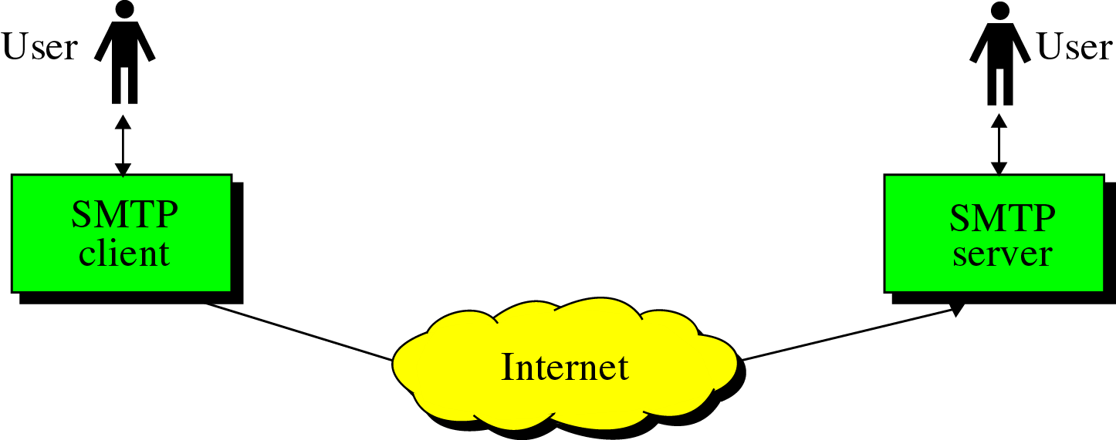
Figure 25-11
SMTP Concept

Slide 13
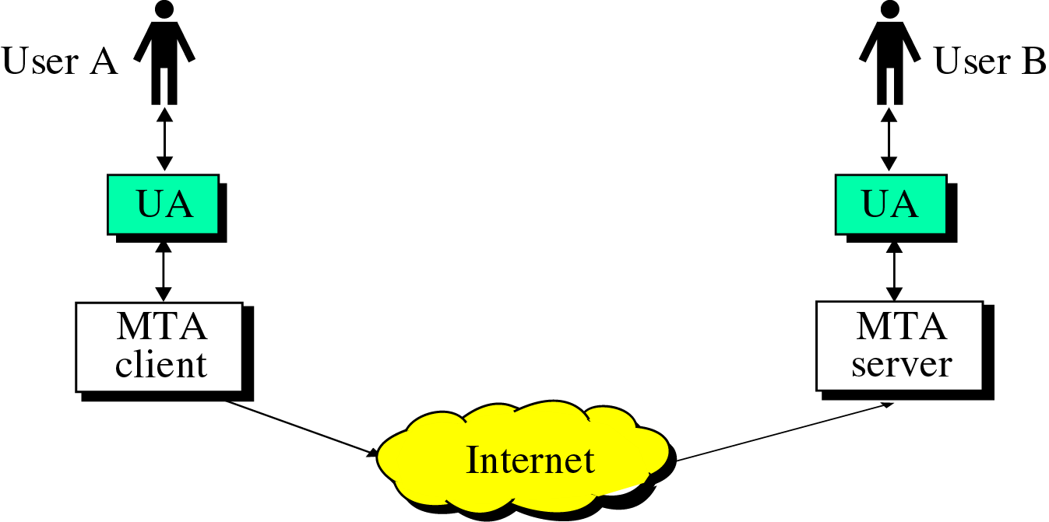
Figure 25-12
UAs and MTs

Slide 14
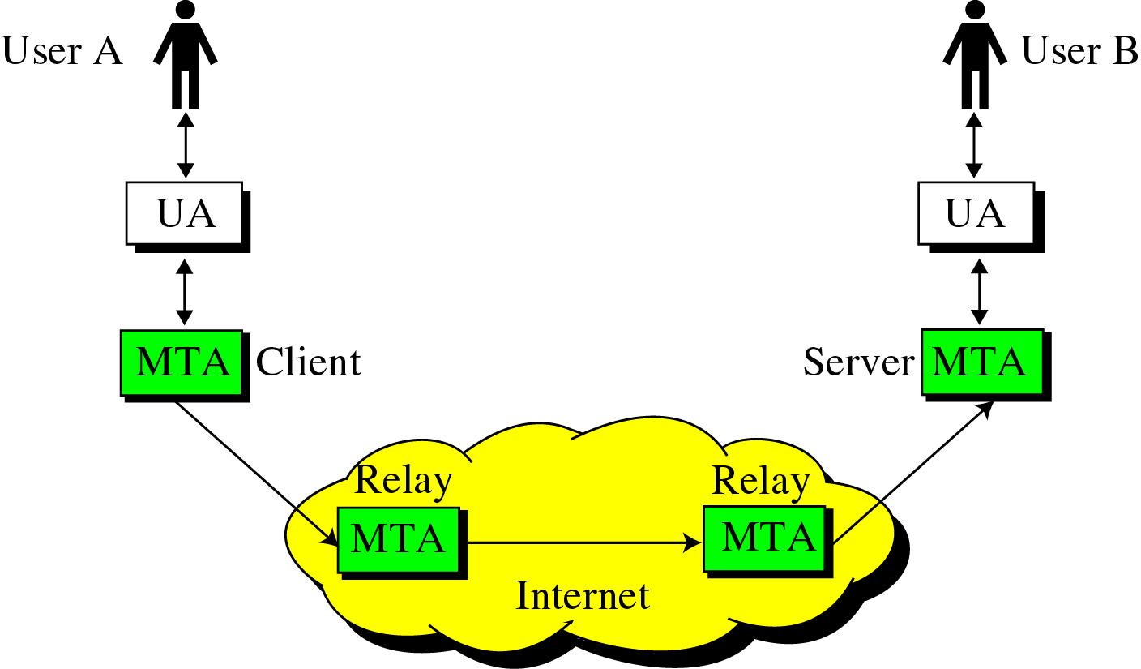
Figure 25-13
Relay MTAs

Slide 15
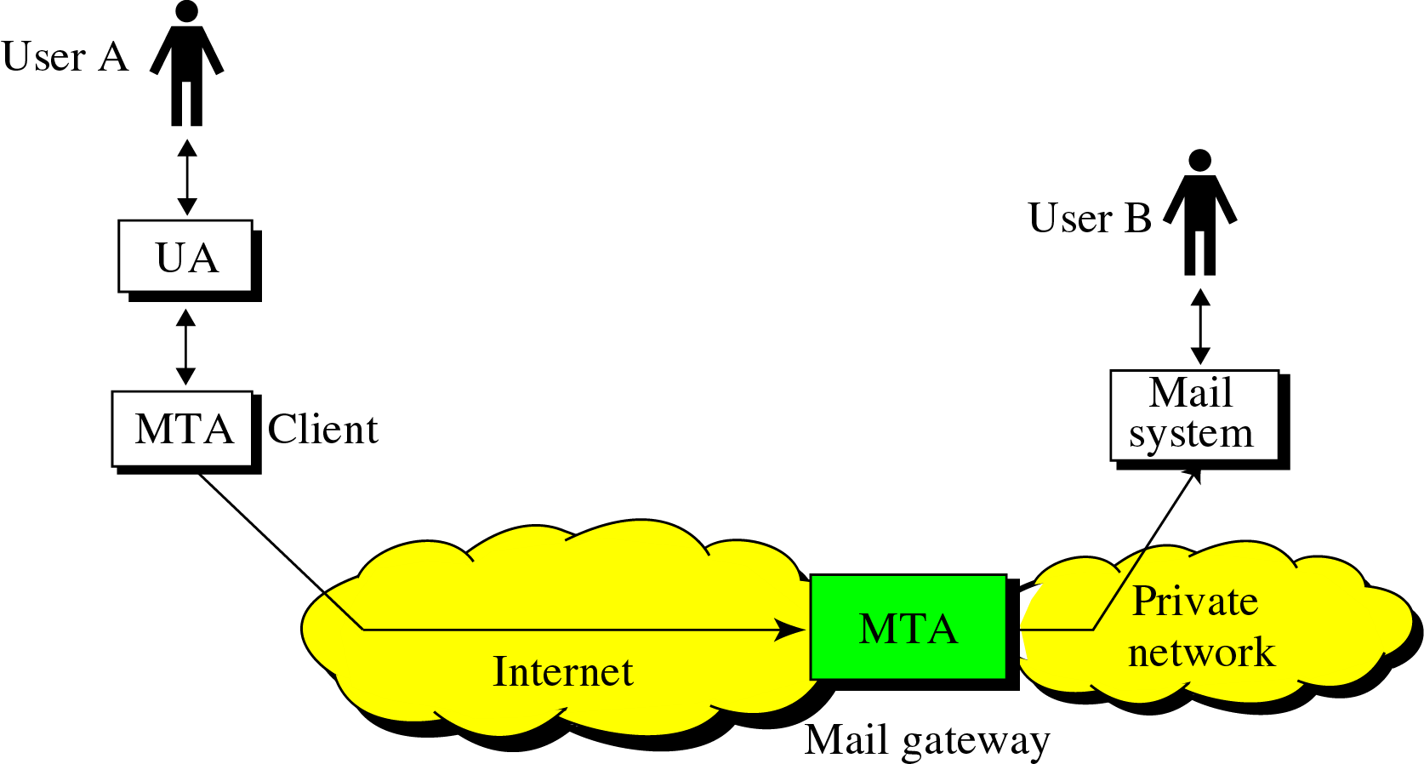
Figure 25-14
Mail Gateways

Slide 16
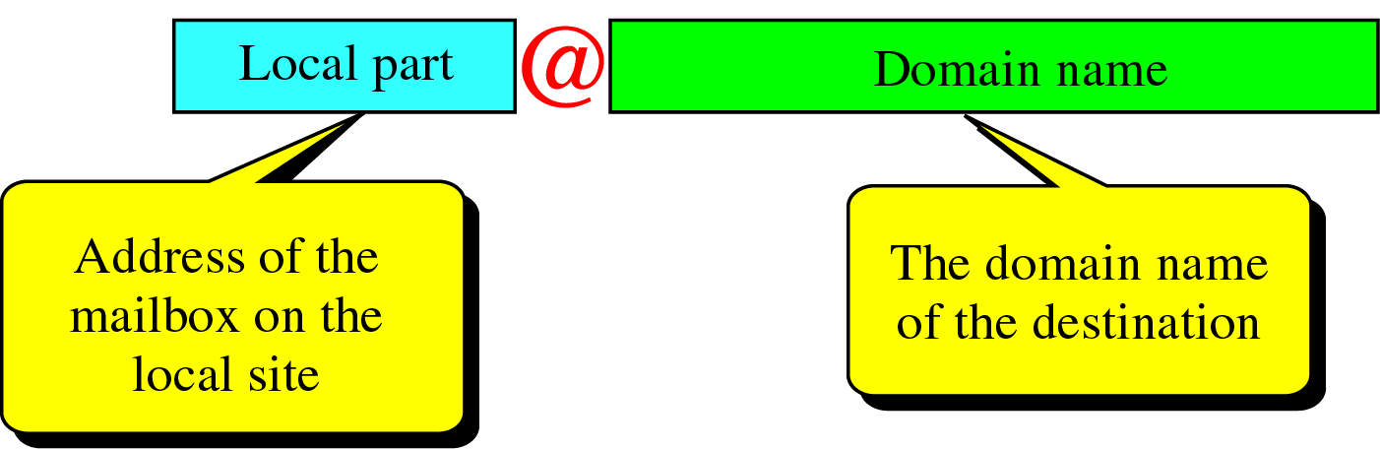
Figure 25-15
E-mail Address

Slide 17
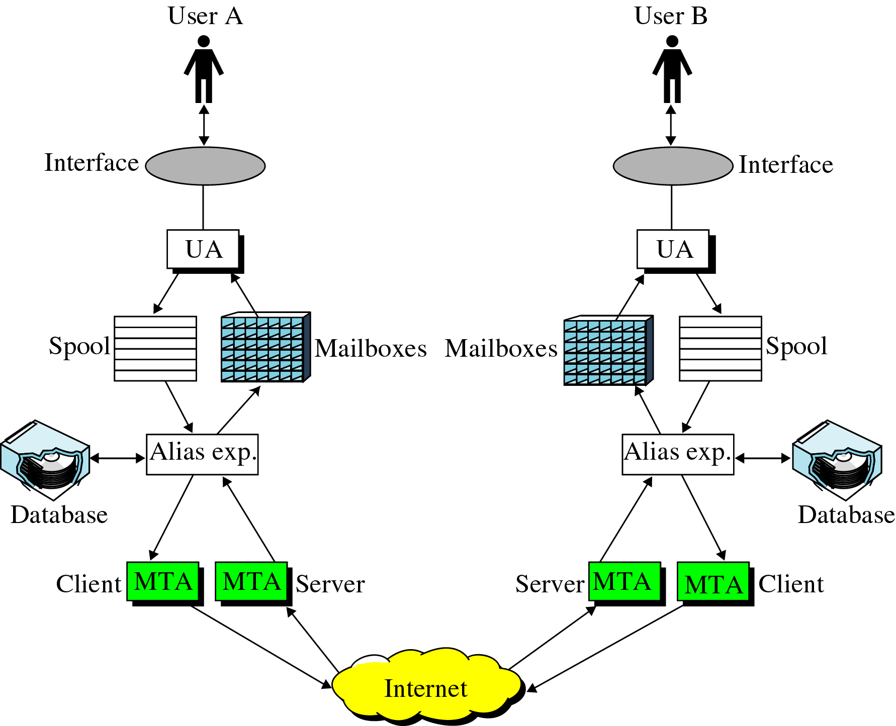
Figure 25-16
The Entire E-mail System

Slide 18
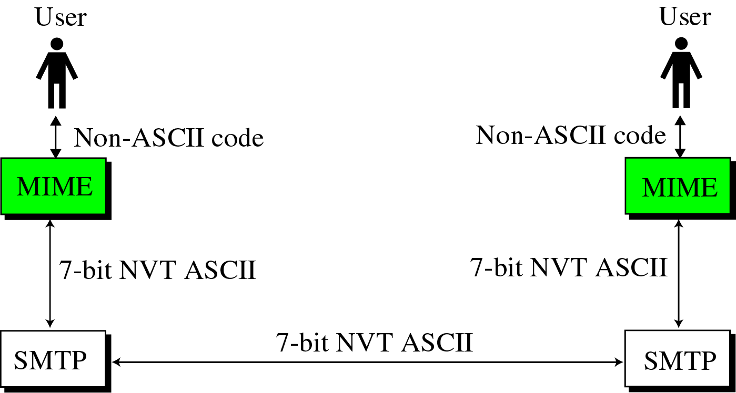
Figure 25-17
MIME

Slide 19
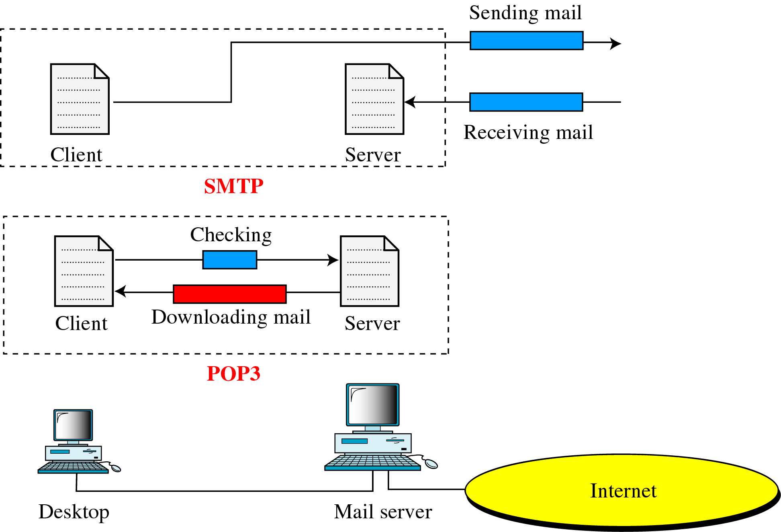
Figure 25-18
POP3 and SMTP

Slide 20
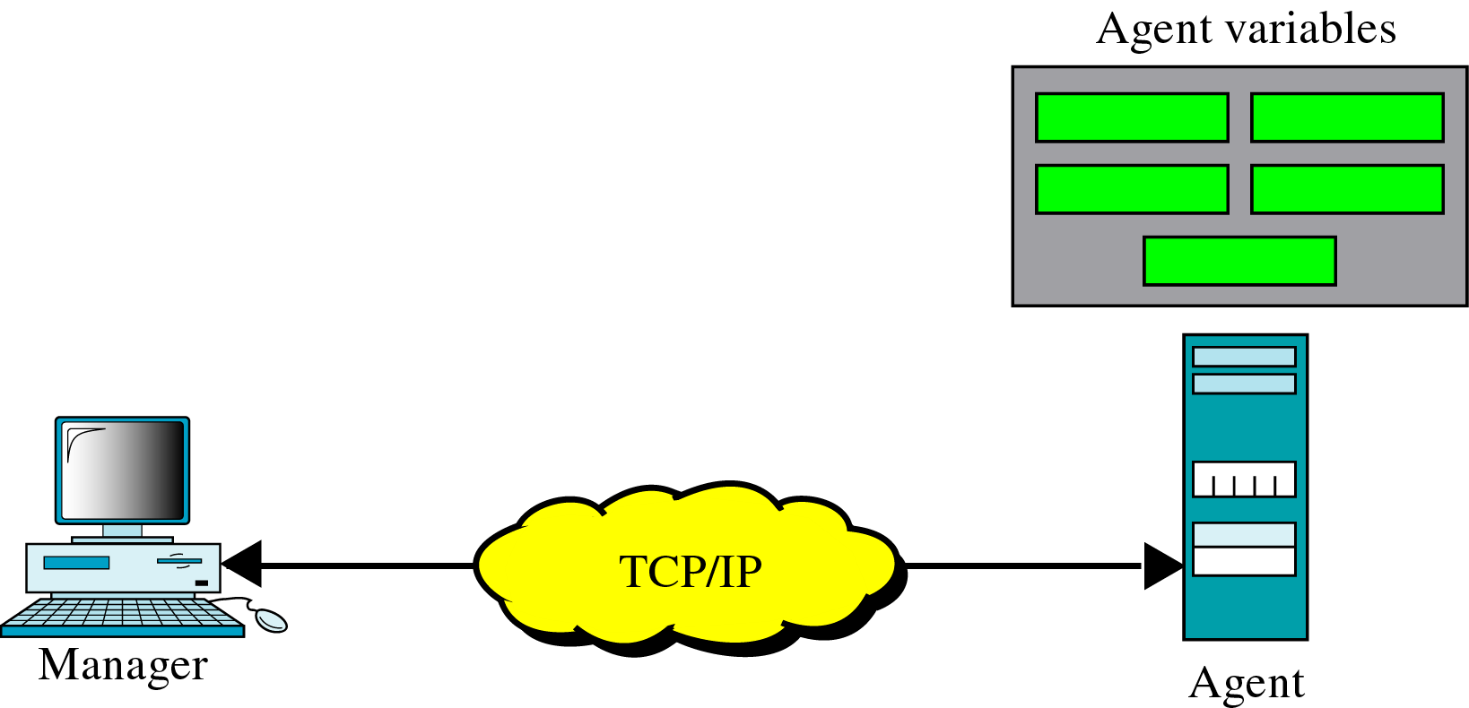
Figure 25-19
SNMP Concept

Slide 21
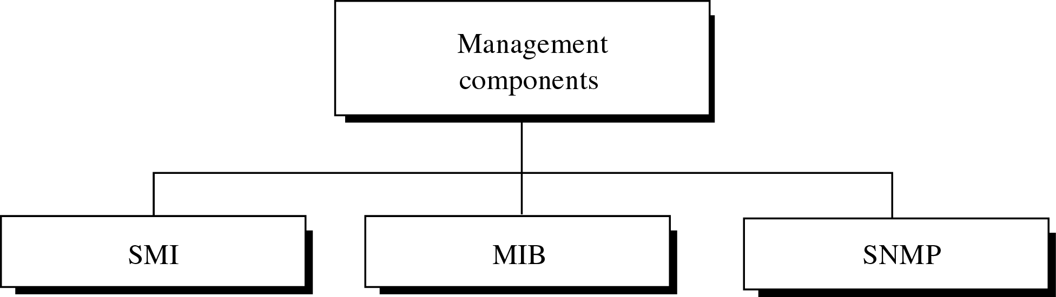
Figure 25-20
Internet Management Components

Slide 22
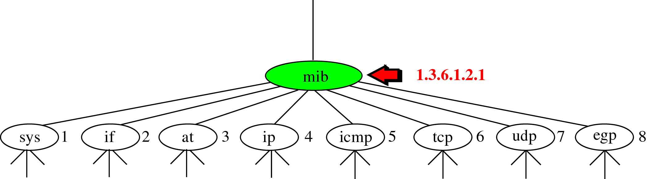
Figure 25-21
MIB

Slide 23
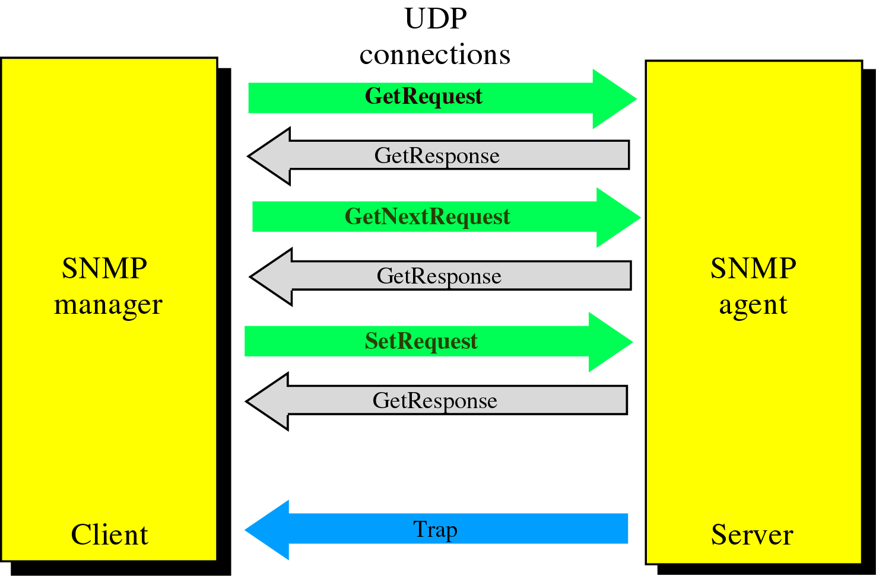
Figure 25-22
SNMP Messages

Slide 24
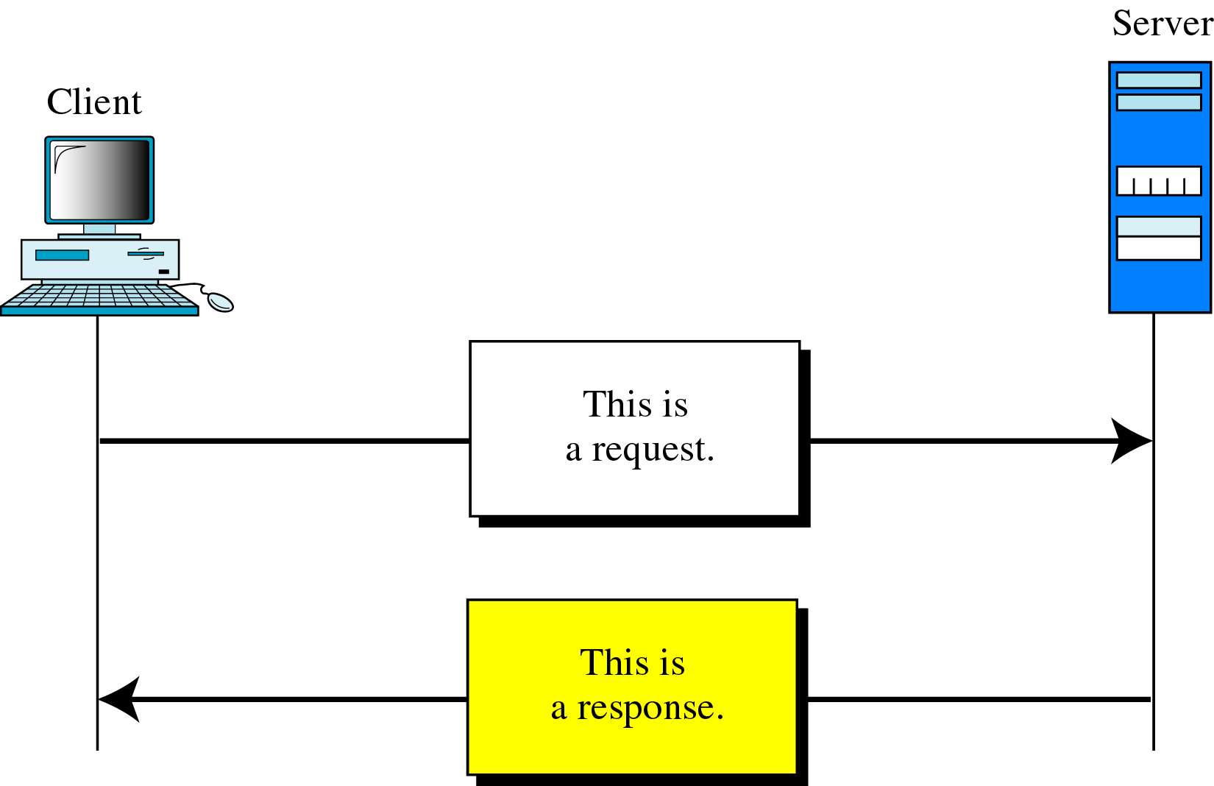
Figure 25-23
HTTP Transaction

Slide 25
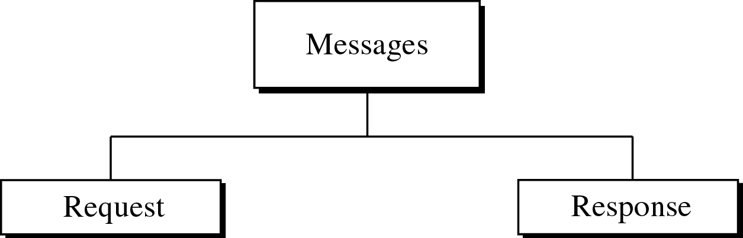
Figure 25-24
Message Categories

Slide 26
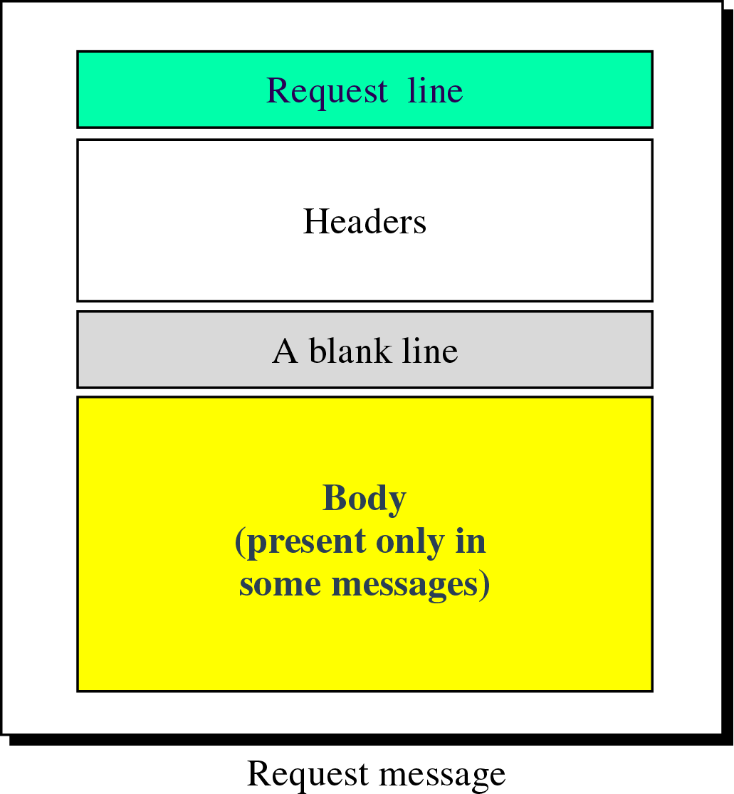
Figure 25-25
Request Message

Slide 27
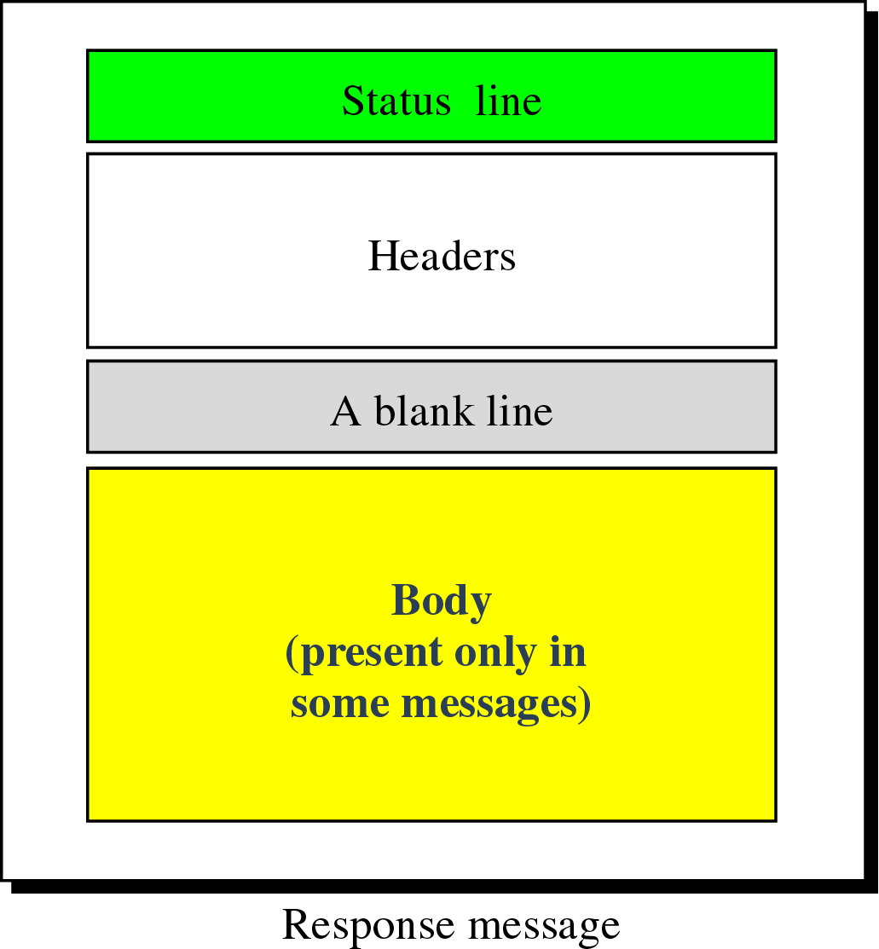
Figure 25-26
Response Message

Slide 28
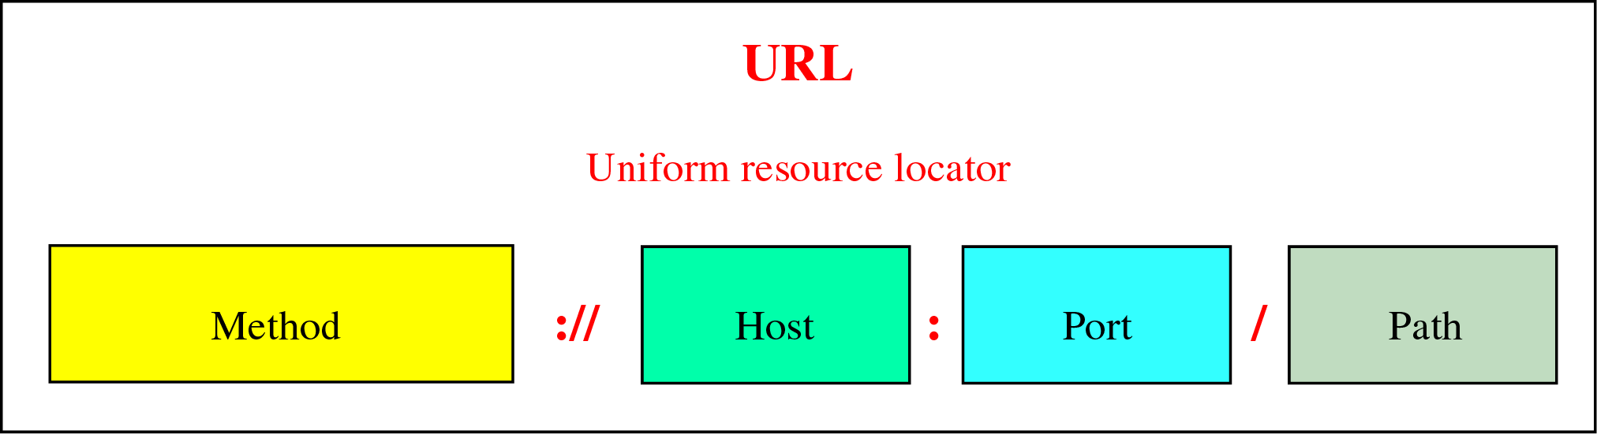
Figure 25-27
URL

Slide 29
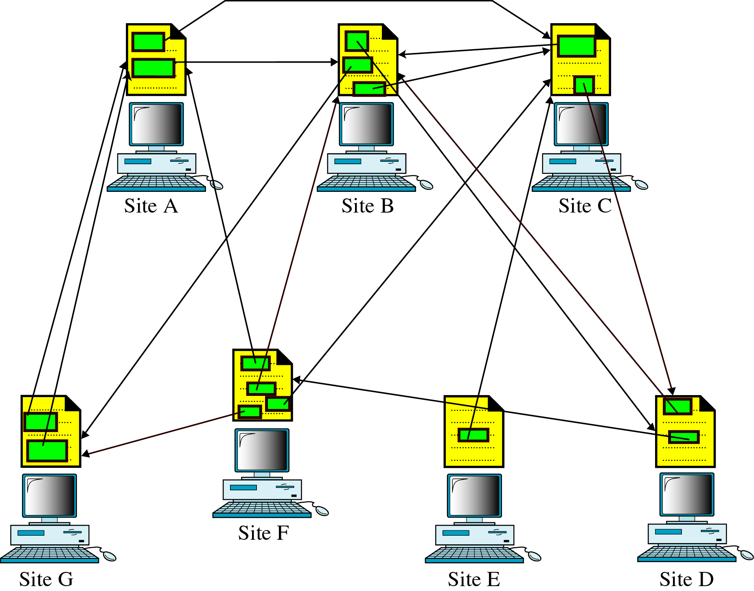
Figure 25-28
Distributed Services

Slide 30
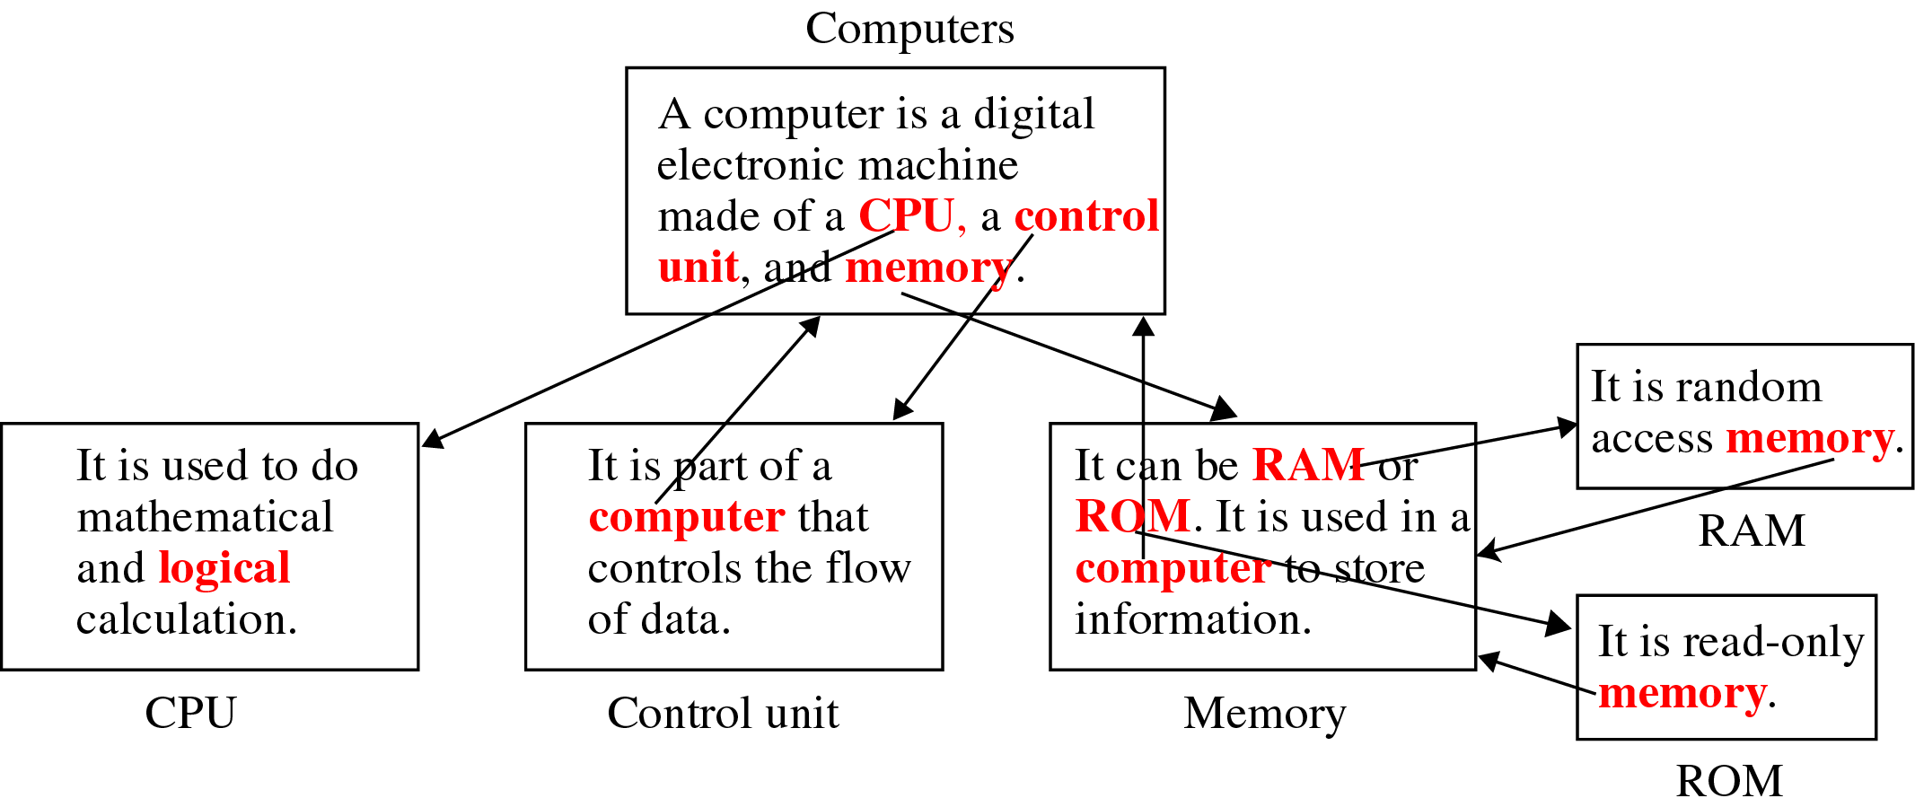
Figure 25-29
Hypertext

Slide 31
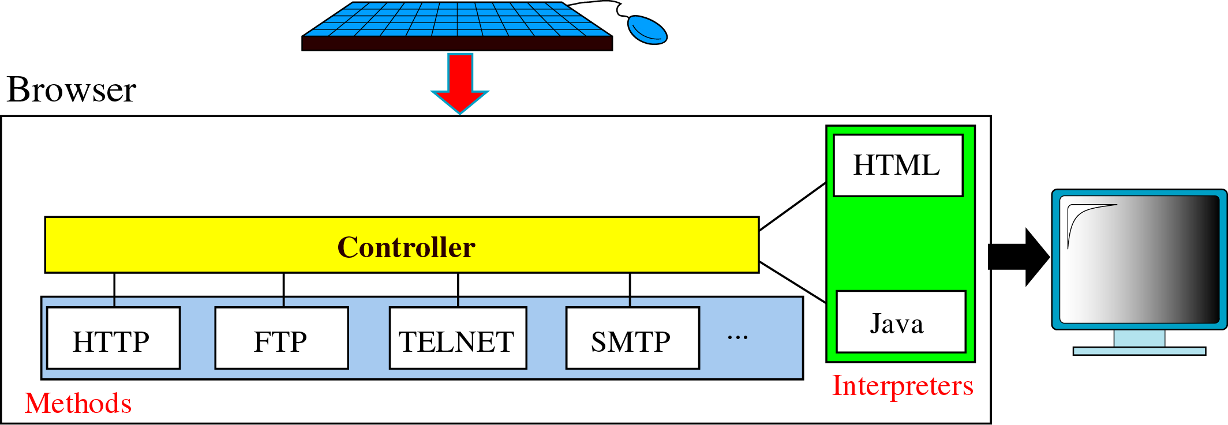
Figure 25-30
Browser Architecture

Slide 32
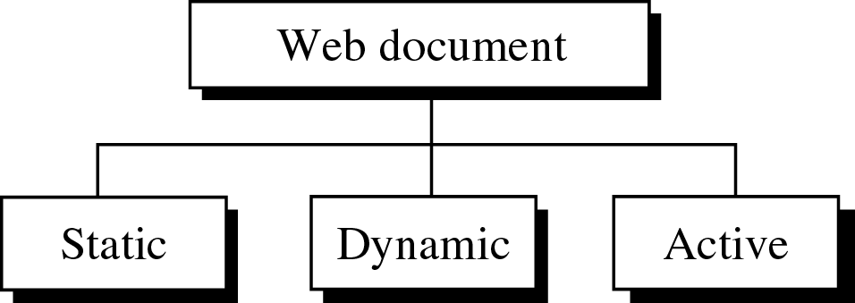
Figure 25-31
Categories of Web Documents

Slide 33
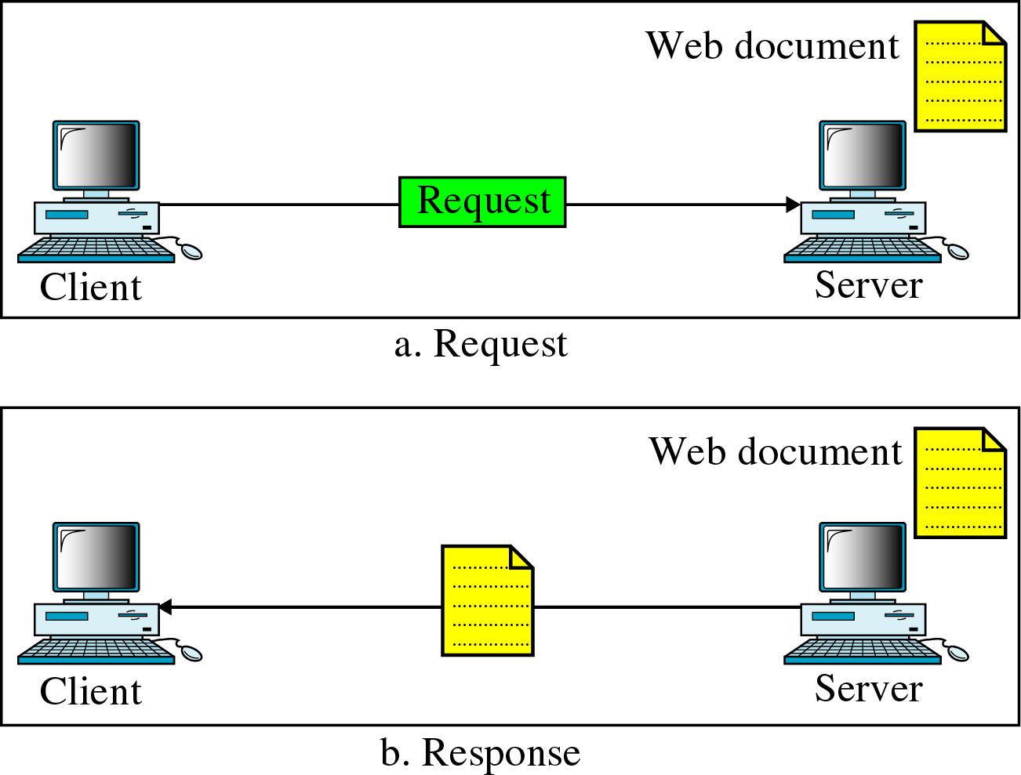
Figure 25-32
Static Document

Slide 34
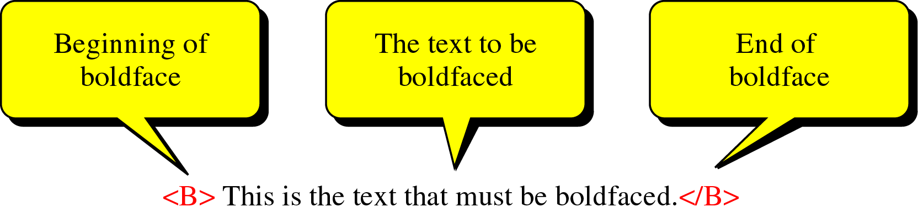
Figure 25-33
Boldface Tags

Slide 35
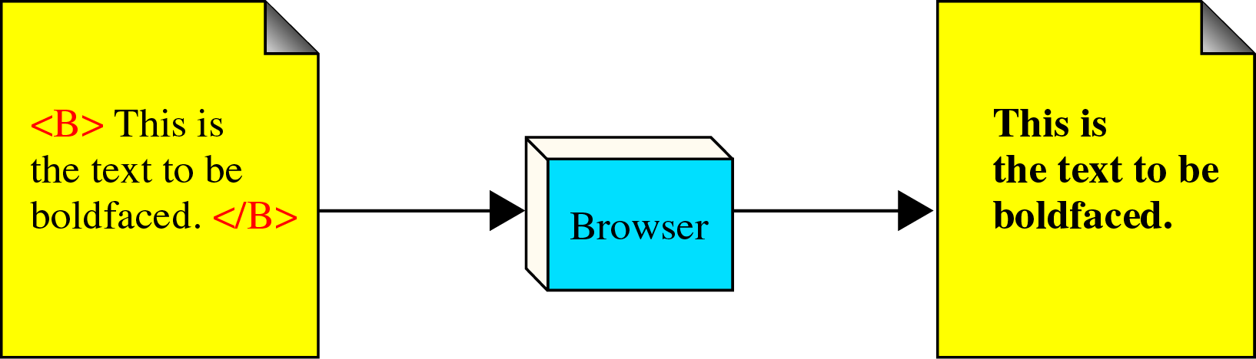
Figure 25-34
Effect of Boldface Tags

Slide 36
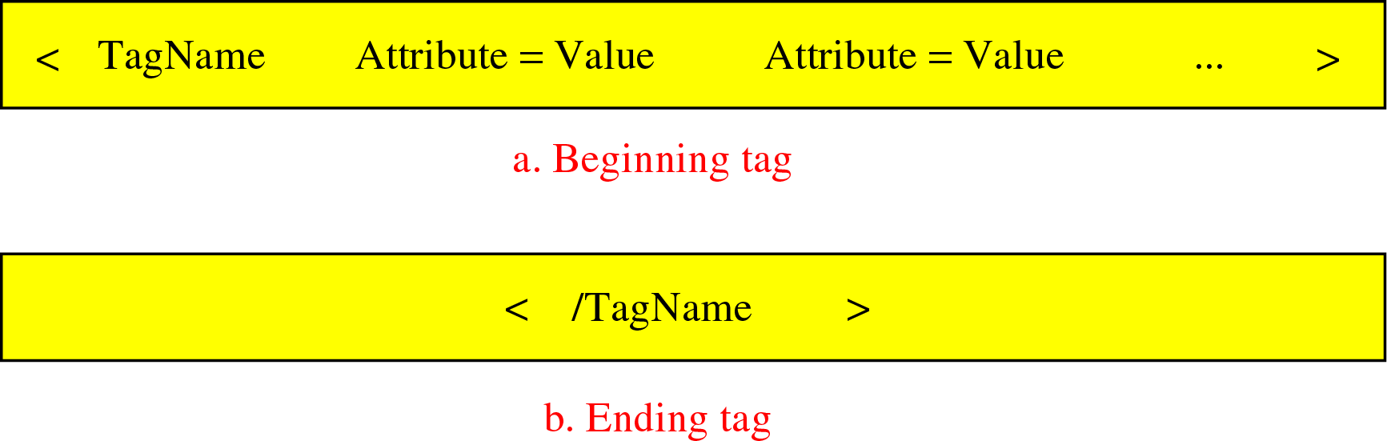
Figure 25-35
Beginning and Ending Tags

Slide 37
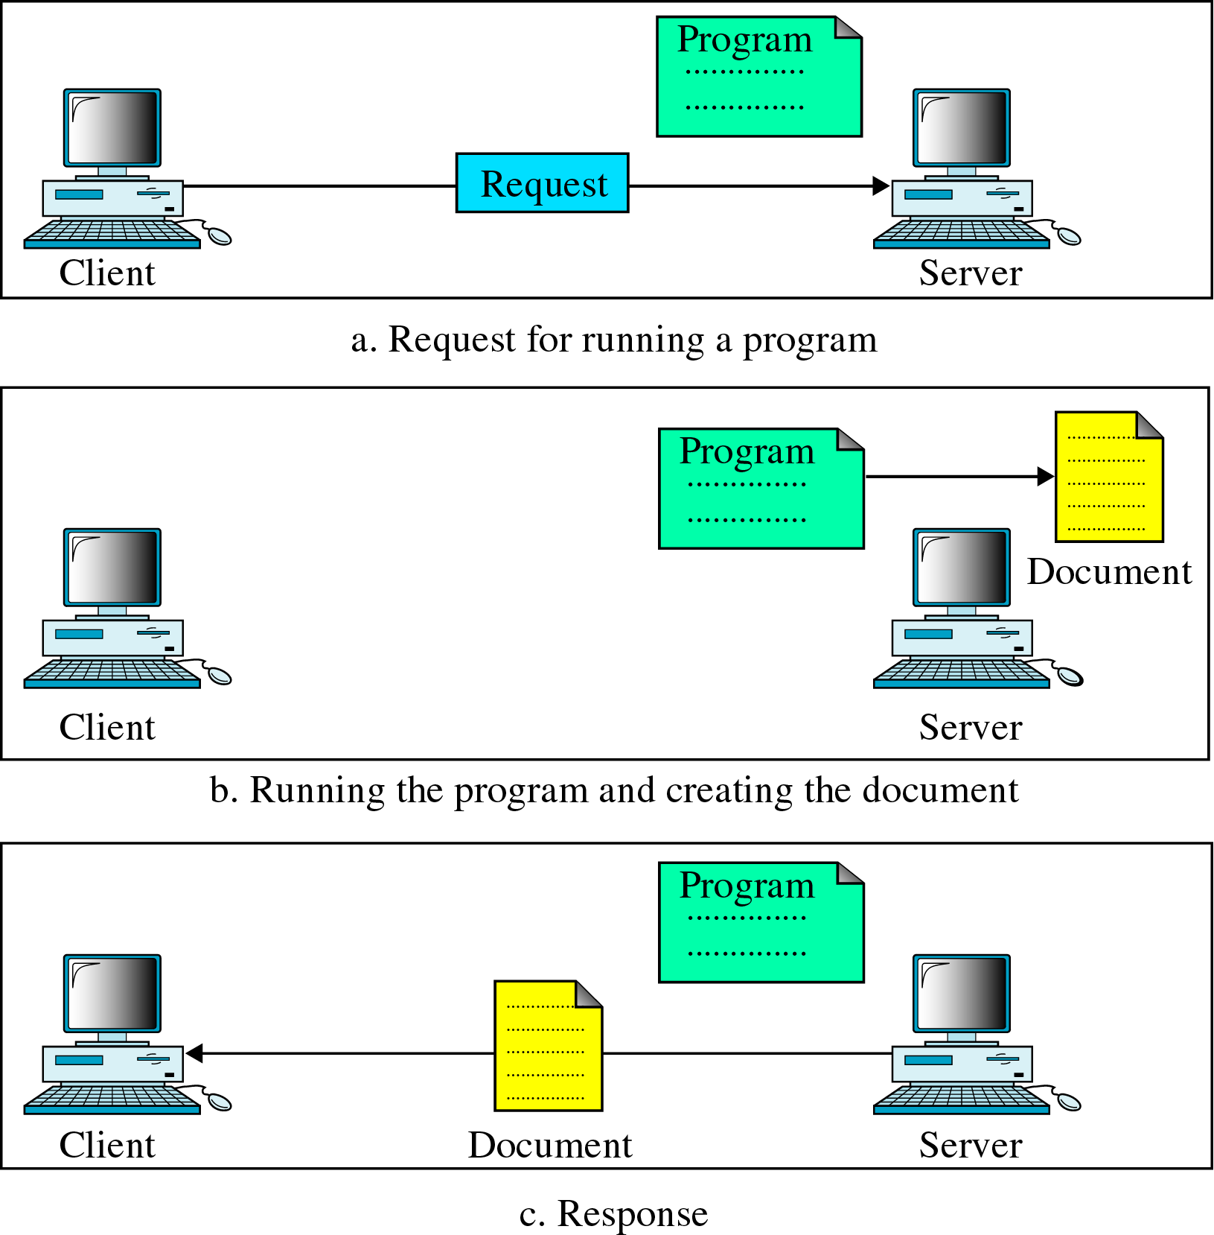
Figure 25-36
Dynamic
Document

Slide 38
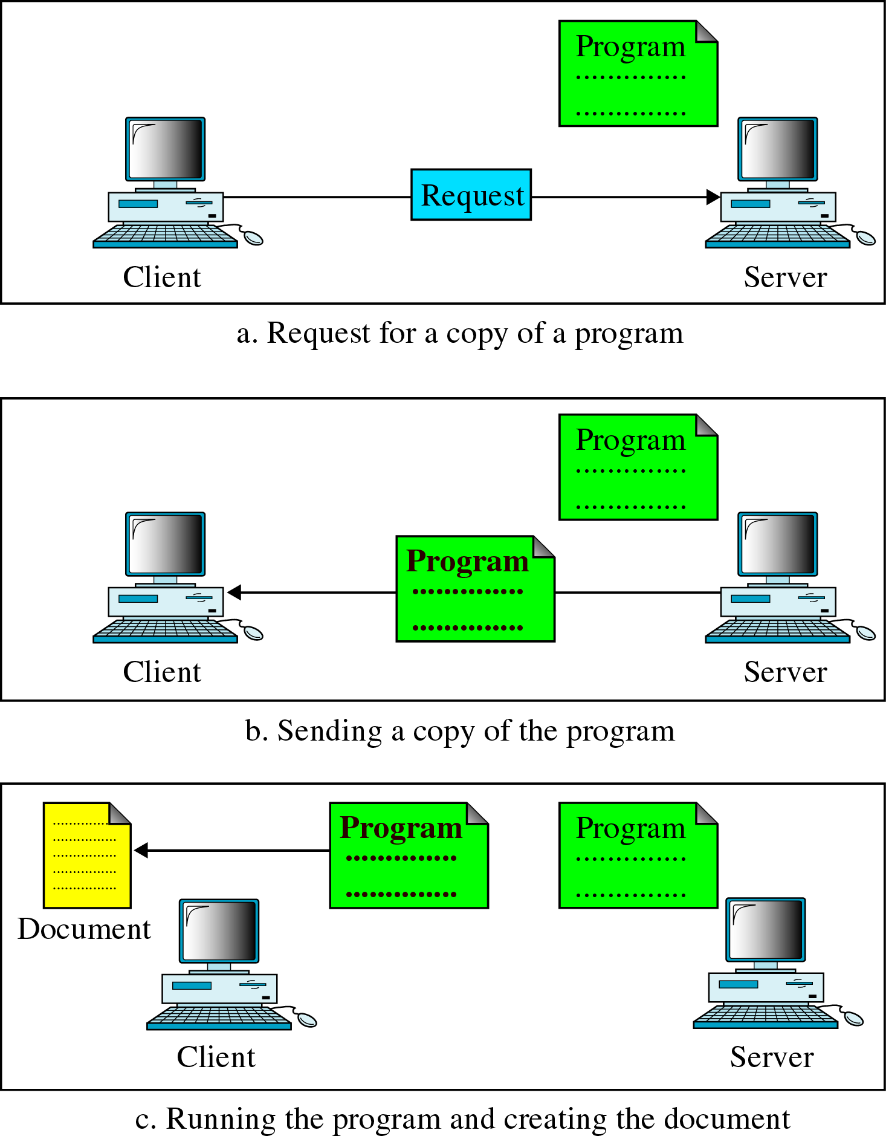
Figure 25-37
Active
Document

